Slide 1
BAIS:3250 Project Check In
Eleanor Scott, Emily Hamling, Maddie Blair

Slide 2
Questions
Research Question 1: What musical features are most common in Billboard Top 10 songs?
Hypothesis: High-energy, high-danceability songs are more likely to reach the top
Research Question 2: Do specific audio features (like danceability, energy, or tempo) significantly differ between songs that peak in the Top 10 versus those that chart lower (Top 11–100)?
Hypothesis: Songs that reach the Top 10 on the Billboard Hot 100 will have higher average danceability, energy, and popularity scores than songs ranked 11 through 100.
Research Question 3: Do high “valence” (positive mood) songs tend to chart higher than sad or aggressive songs?
Hypothesis: Happy-sounding songs are more commercially successful.

Slide 3
Data Sources and Dataset Overview
Sources:
Billboard Hot 100: Web-scraped
Spotify Audio Features: Kaggle dataset
Cleaning Steps:
Dropped full duplicates
Standardized column names
Combined song titles and artists
Removed duplicate songs
Final cleaned dataset: 273 unique songs

Slide 4
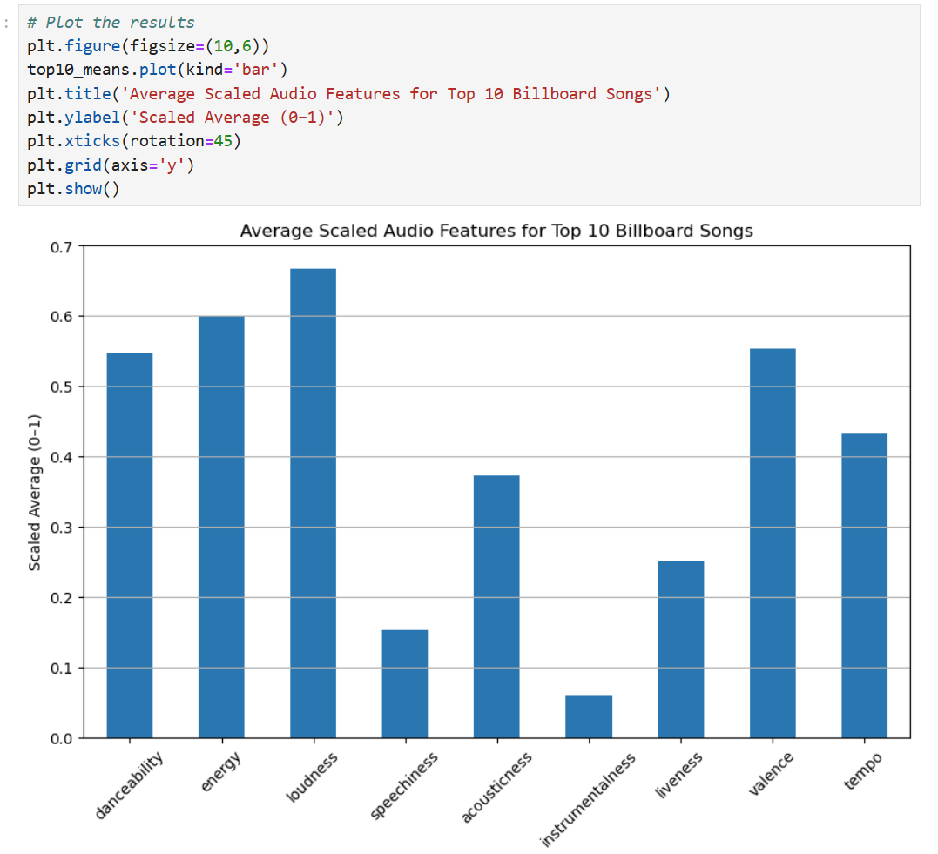
Univariate Analysis – Common Features in Top 10
Method:
Selected key Spotify features
Min-Max scaled features to [0–1]
Averaged scaled values
Key Findings: Top 10 songs tend to have higher energy, danceability, loudness and valence compared to other features.
We were surprised by loudness

Slide 5
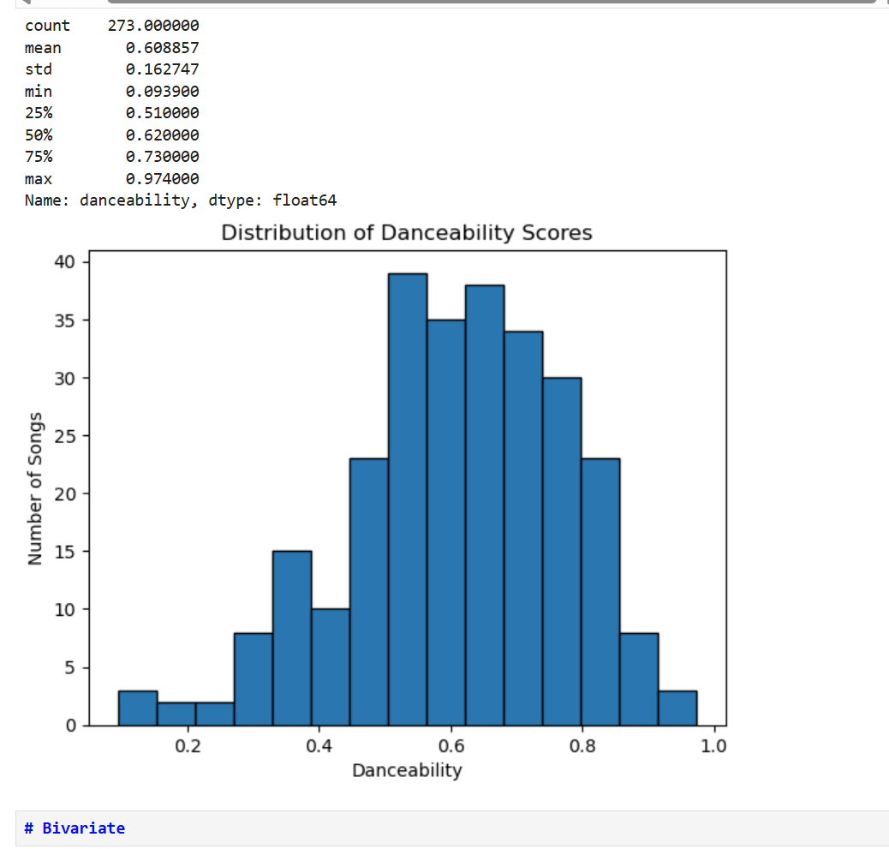
Example of Just Danceability To Accurately Compare

Slide 6

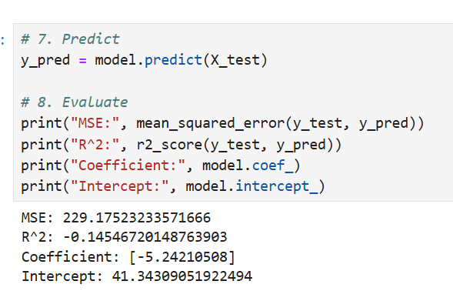
Machine Learning Research Question: :Do high “valence” (positive mood) songs tend to chart higher than sad or aggressive songs?
Feature Used:
Valence (positivity of a song)
Target Variable:
Spotify Daily Rank
Model Type:
Simple Linear Regression
Results:
Mean Squared Error (MSE): 229.18
R-squared (Test Set): -0.15
Coefficient: -5.24
Intercept: 41.34
Interpretation:
Happier songs tend to have slightly better Spotify ranks, but valence alone is a weak predictor of success.

Slide 7
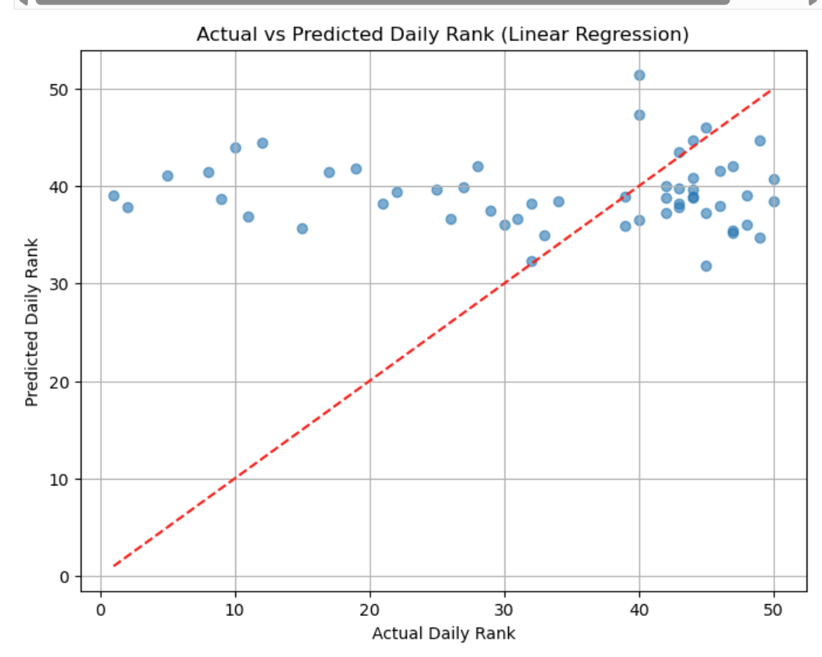
Machine Learning
We wanted to make it more difficult using multiple audio features with target variable of daily rank (like before)
Results:
Mean Squared Error (MSE): 229.18
R-squared (R²): -0.24 – means our model is bad at predicting as clearly shown in visual
Key Findings: Predicting daily rank from audio features is challenging. Liveness, tempo, and danceability had the largest positive effects on rank. Valence and loudness were negatively correlated with better ranks.
Visualization: Scatterplot of Actual vs Predicted Daily Ranks

Slide 8
Updated Data Dictionary
Field | Type | Description
title | String | Song Title
artist_combined | String | Name of artist (combined from Spotify dataset and Billboard)
album_name | String | Name of album the track is found on
spotify_id | Alpha Numeric | Unique Spotify ID
danceability | Float | Suitability for dancing (0.0–1.0)
energy | Float | Intensity and activity level (0.0–1.0)
valence | Float | Musical positiveness (0.0–1.0)
tempo | Float | Beats per minute
speechiness | Float | Presence of spoken word
instrumentalness | Float | Likelihood of being instrumental
acousticness | Float | Confidence the track is acoustic
liveness | Float | Probability that the track was recorded live
peak_position | Integer | Highest Billboard rank
weeks_on_chart | Integer | Weeks on Billboard chart
daily_rank | Integer | Rank of track
daily_movement | Integer | Movement of track per day
weekly_movement | Integer | Movement of track in a certain week
country | String | Country the song was released in (if known)
snapshot_date | Date | Date the track information was taken from Spotify
album_release_date | Date | Date the album the track is in was released
time_signature | Integer | Indicates beats per measure
primary_artist | String | Primary artist on the track
key | Integer | Key the track is in
loudness | Float | Volume of track in decibels
mode | Boolean | Track scale, depicted by a 0 or 1
popularity | Integer | Popularity of track
is_explicit | Boolean | Whether the track is explicit

Slide 9
Challenges Encountered
Merging Billboard and Spotify data:
Song titles and artist names were not always consistent across platforms (differences in spelling, punctuation, or featuring artists).
Solution: We cleaned and standardized text fields (lowercase, stripped spaces) and combined different columns to create unified title and artist_combined fields.
Duplicate Entries and Multiple Observations:
Some songs had multiple rows (due to daily Spotify snapshots).
Solution: We grouped by song title and artist and averaged audio features while taking the best (lowest) Billboard rank.
Machine Learning Results:
Using only one audio feature (valence) to predict daily Spotify rank resulted in a negative R² score, indicating poor predictive strength.
Future Improvement: Consider using multiple features together for better model performance.

Slide 10
Road Map
Bivariate Analysis
Hypothesis Test
Answer final 2 research questions
Compare findings to original hypotheses
Complete final report
Update project introduction
Create final data dictionary and cite data sources
Write final analysis of research questions and their results
Finalize project with a conclusion including a reflection of our project and suggestions for future work

